Slide 1


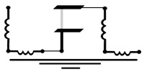
Tutorial 3: ML Interpolation in SQuADDS
Sadman Ahmed Shanto
Qiskit Fall Fest 2024
10/16/24
Superconducting Qubit And Device Design and Simulation database

Slide 2
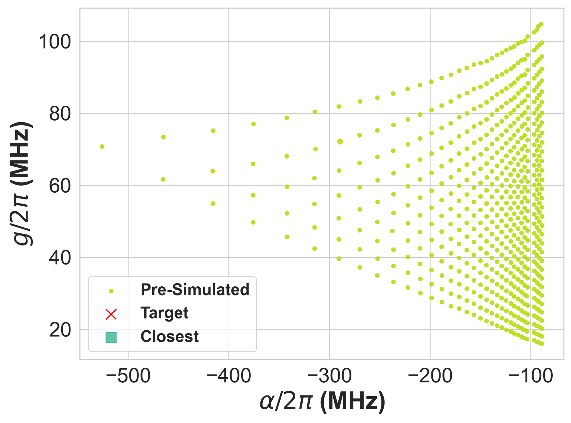
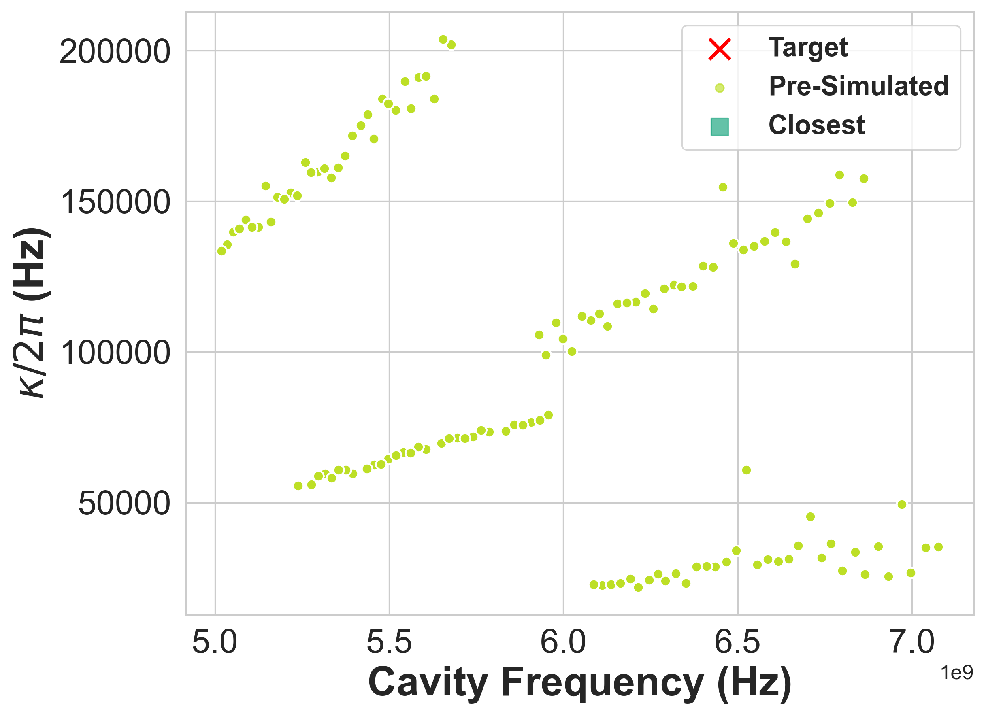
Motivation for Interpolation

Slide 3
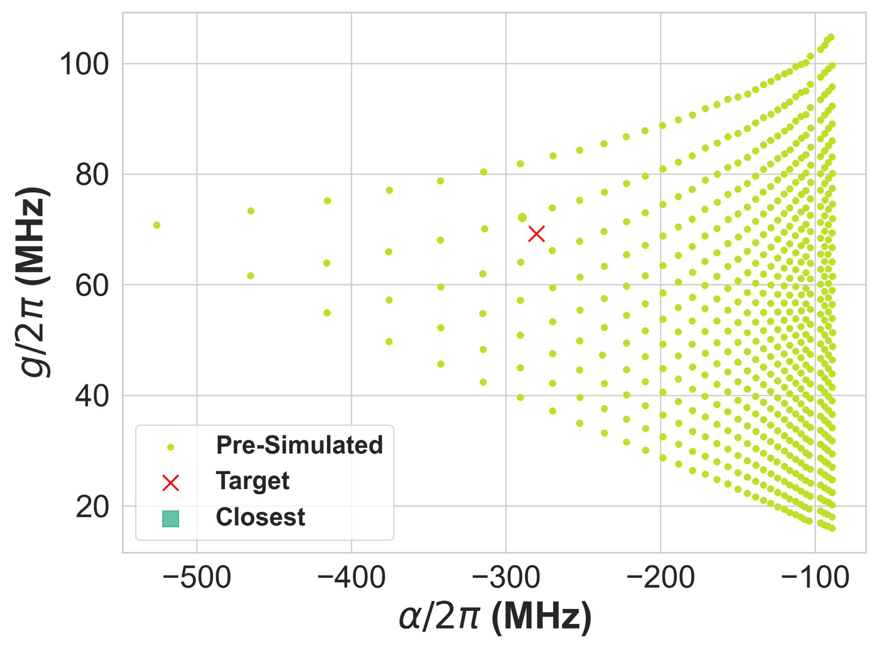
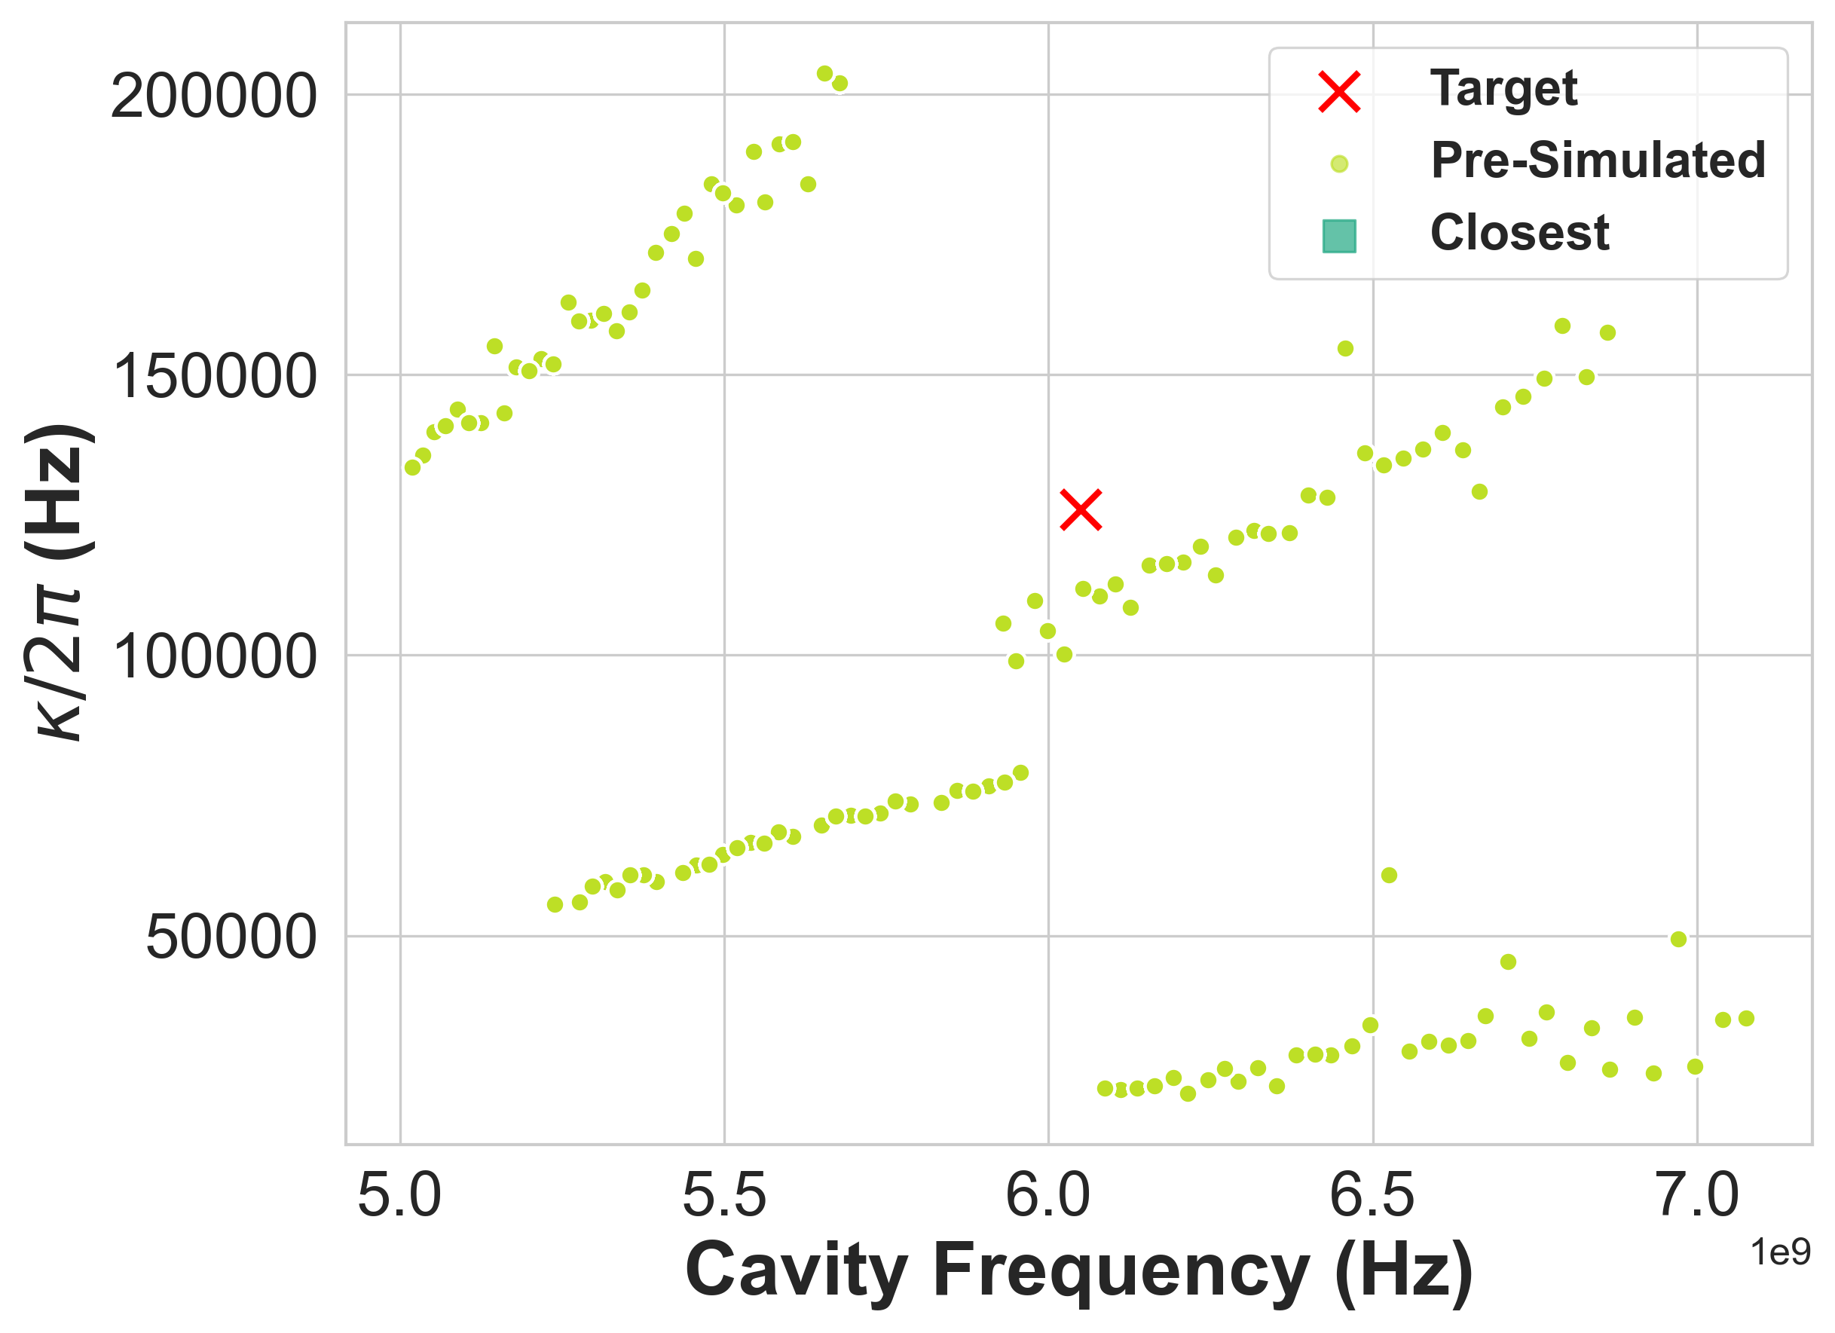
Motivation for Interpolation
Notes:
\Now lets say, you want a design for which we don’t have the corresponding Hamiltonian parameters presimulated and you are not happy with the closest design.

Slide 4
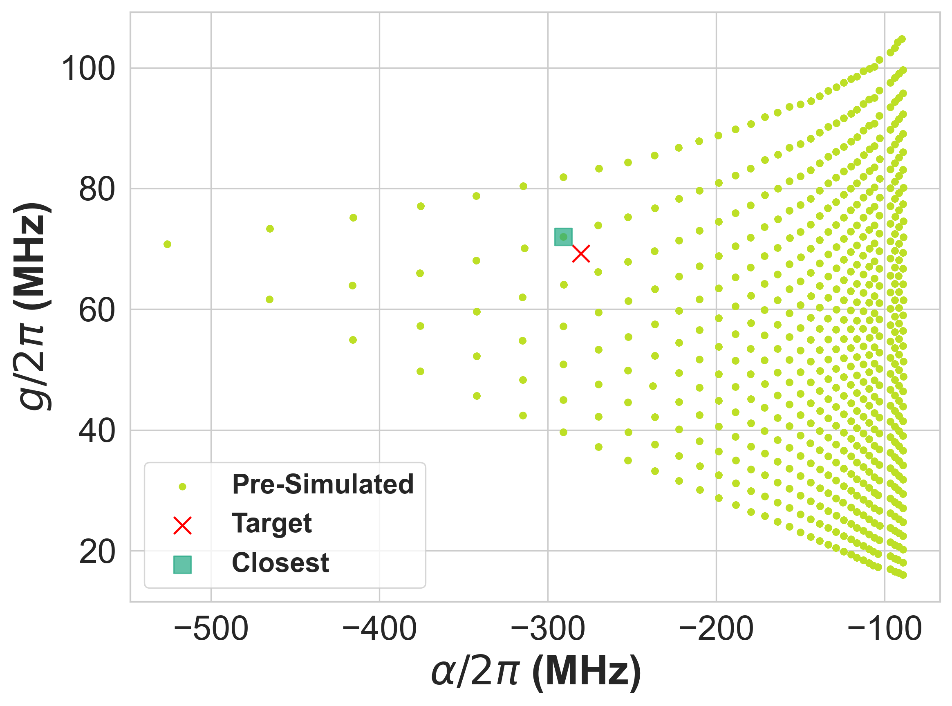
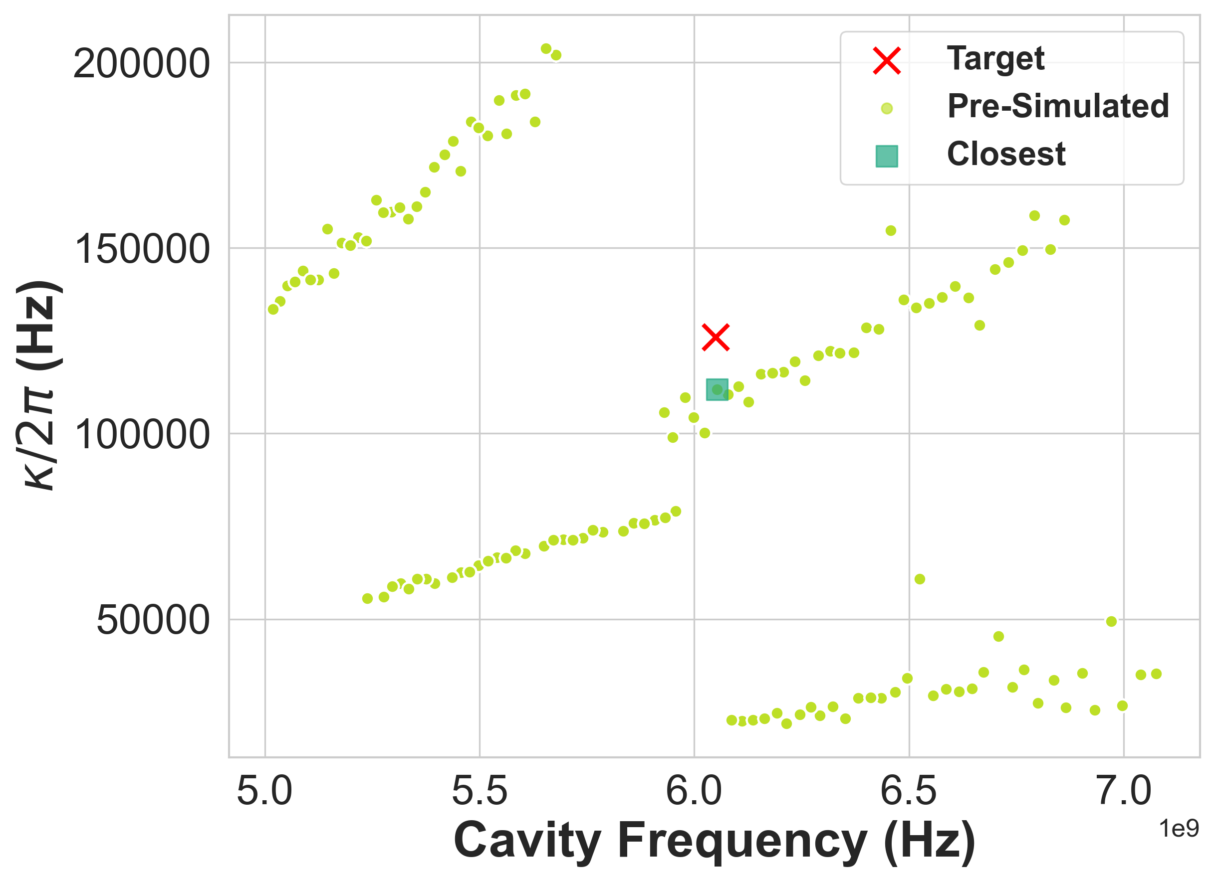
Motivation for Interpolation
Notes:
SQuADDS provides an interpolation algorithm inspired by the physics of the problem to create a best guess design for your target Hamiltonian.

Slide 5
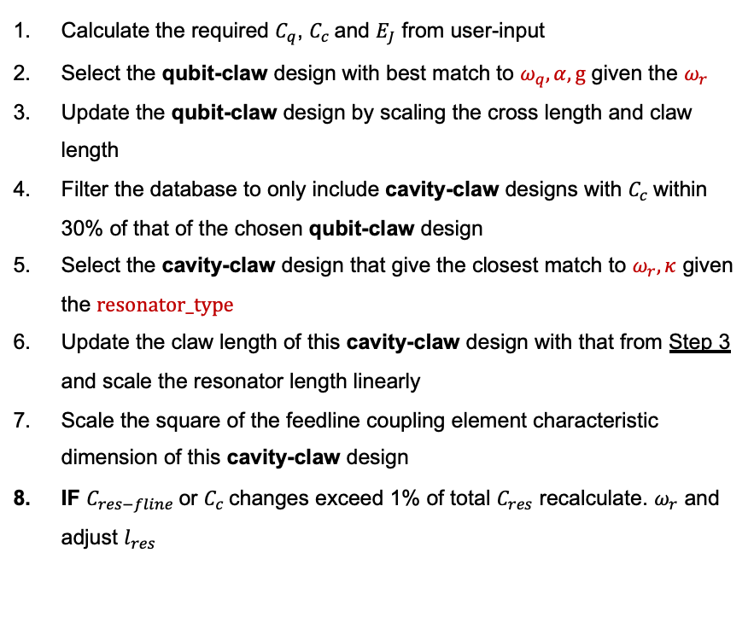
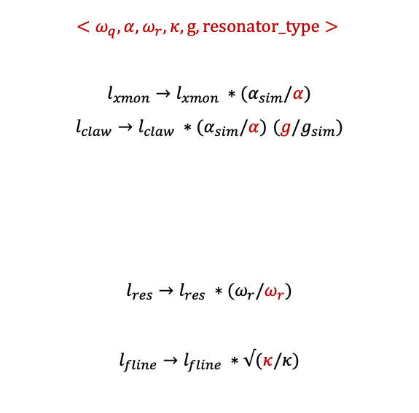
Interpolation Algorithm
Calculate the required $C_{q}$, $C_{c}$and $E_{J}$ from user-input
Select the qubit-claw design with best match to $ω_{q},α, g$ given the $ω_{r}$
Update the qubit-claw design by scaling the cross length and claw length
Filter the database to only include cavity-claw designs with $C_{c}$within 30% of that of the chosen qubit-claw design
Select the cavity-claw design that give the closest match to $ω_{r},κ$ given the $resonator_type$
Update the claw length of this cavity-claw design with that from Step 3 and scale the resonator length linearly
Scale the square of the feedline coupling element characteristic dimension of this cavity-claw design
IF $C_{res−fline}$or $C_{c}$changes exceed 1% of total $C_{res}$ recalculate. $ω_{r}$ and adjust $l_{res}$
$${<ω}_{q},α, ω_{r},κ,g,resonator_type>$$
$$l_{xmon}→l_{xmon} ∗(α_{sim}/α)$$
$l_{claw}→l_{claw} ∗(α_{sim}/α)$ $(g/g_{sim})$
$$l_{res}→l_{res} ∗(ω_{r}/ω_{r})$$
$$l_{fline}→l_{fline} ∗√(κ/κ)$$
Notes:
Here, is the algorithm. It is a bit long and complicated and specific to the particular problem but it does work well.

Slide 6
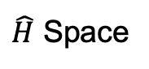
Arbitrary Physics Inspired Interpolation Algorithm
VERY TOUGH!
$\hat{H}$ Space
Design Space

Slide 7
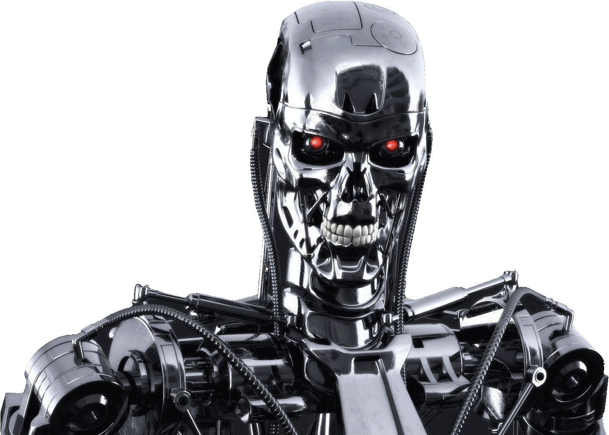
ML Inspired Interpolation Algorithm
$\hat{H}$ Space
Design Space

Slide 8
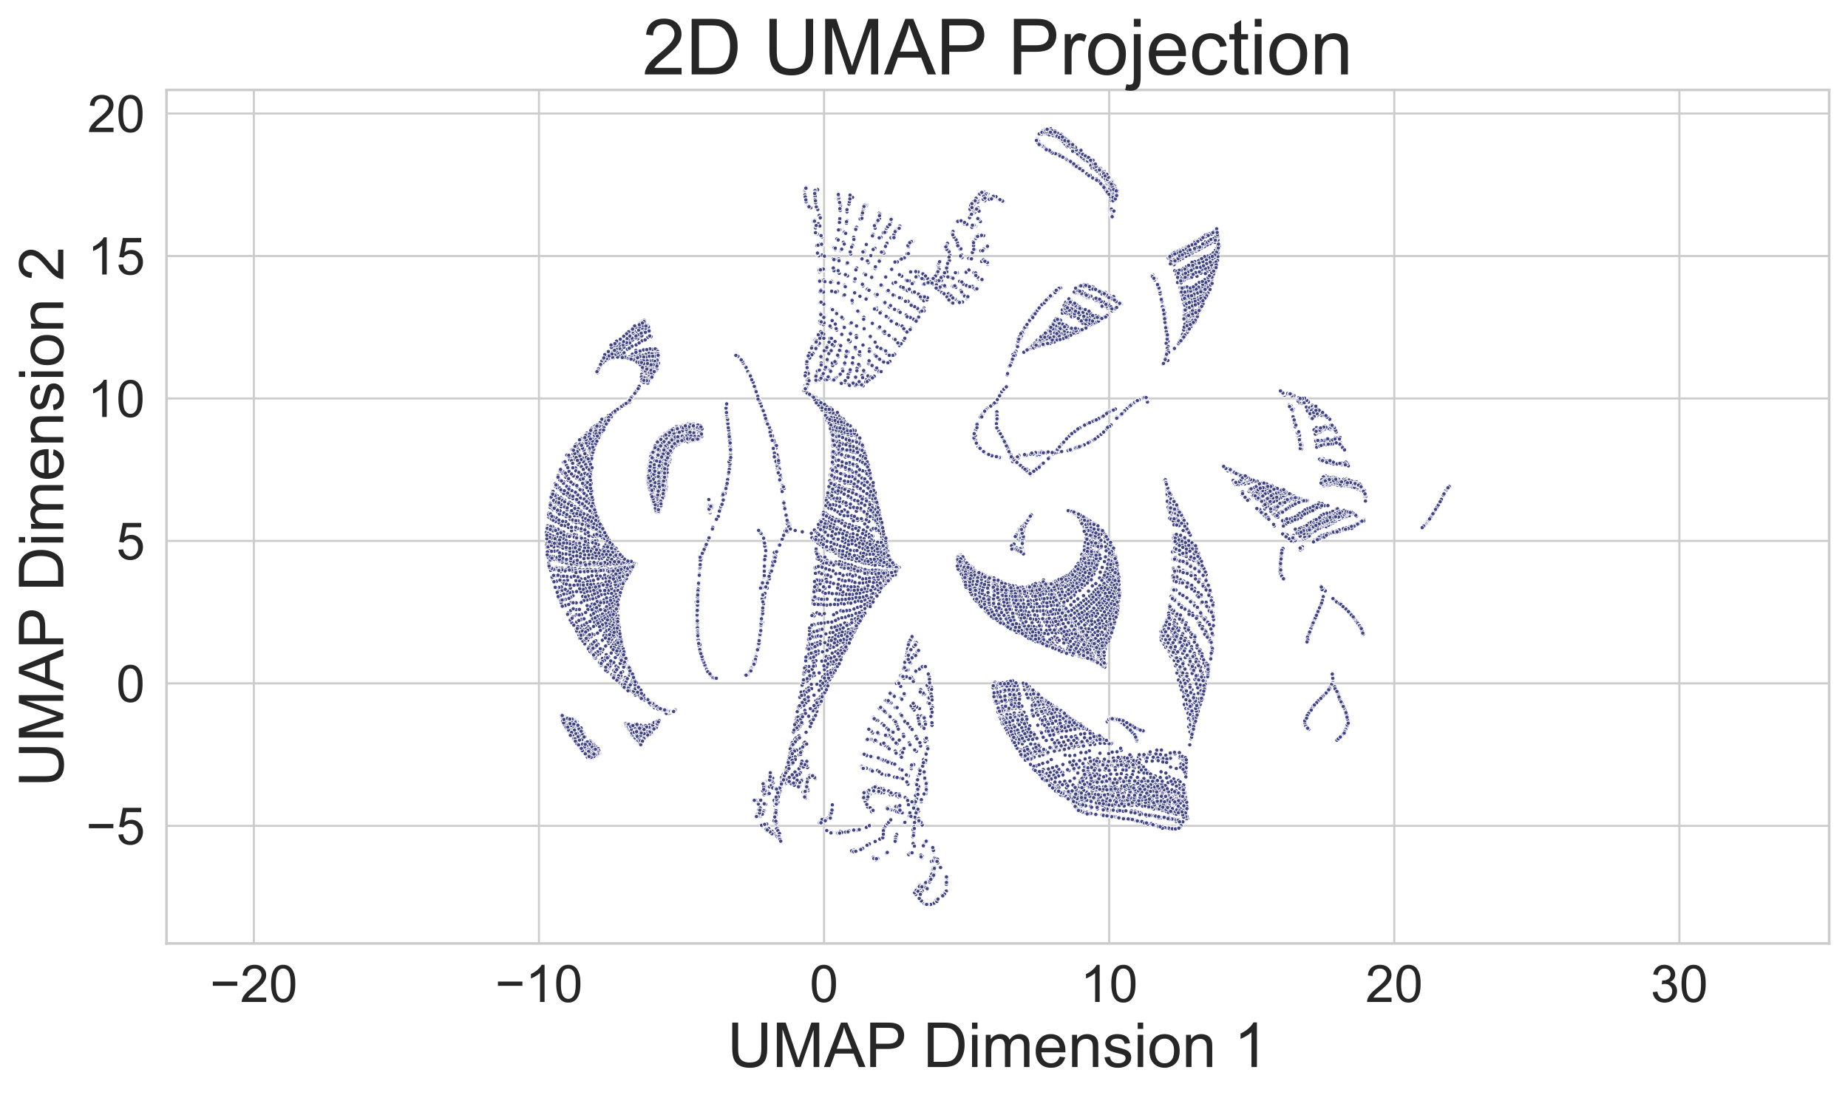
ML Inspired Interpolation Algorithm
Learnable Structures in our data
Notes:
So the first thing we want to verify if there are indeed learnable structures in our database and this 2D UMAP representation shows that it is indeed the case.

Slide 9
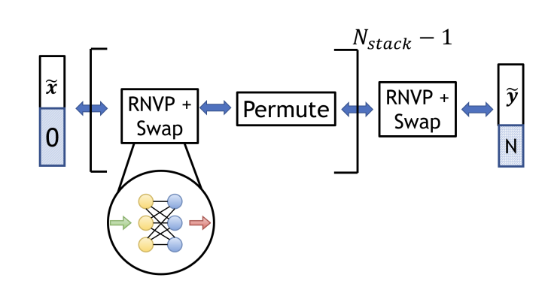
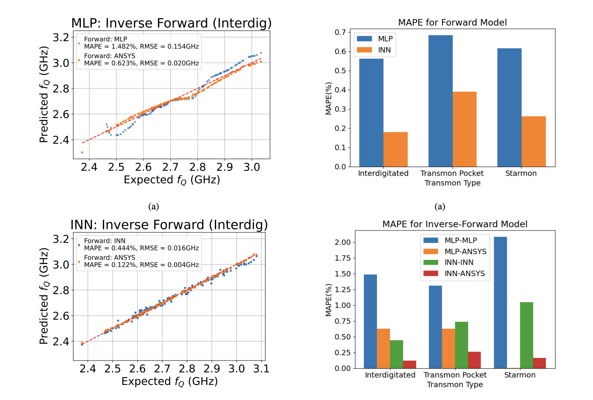
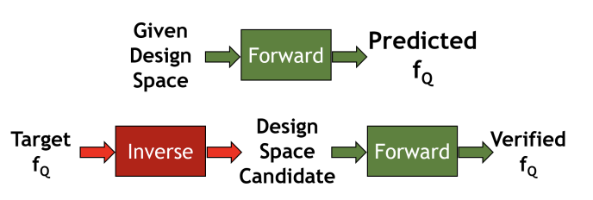
ML Inspired Interpolation Algorithm
^{[1]}
Learnable Structures in our data
Invertible Neural Network (INN) with repetitions of RealNVP coupling layers Architecture ^{[1]}
^{[1]}
^{[1]}
^{[1]} Nugraha Et al., https://doi.org/10.1109/QCE57702.2023.00154

Slide 10
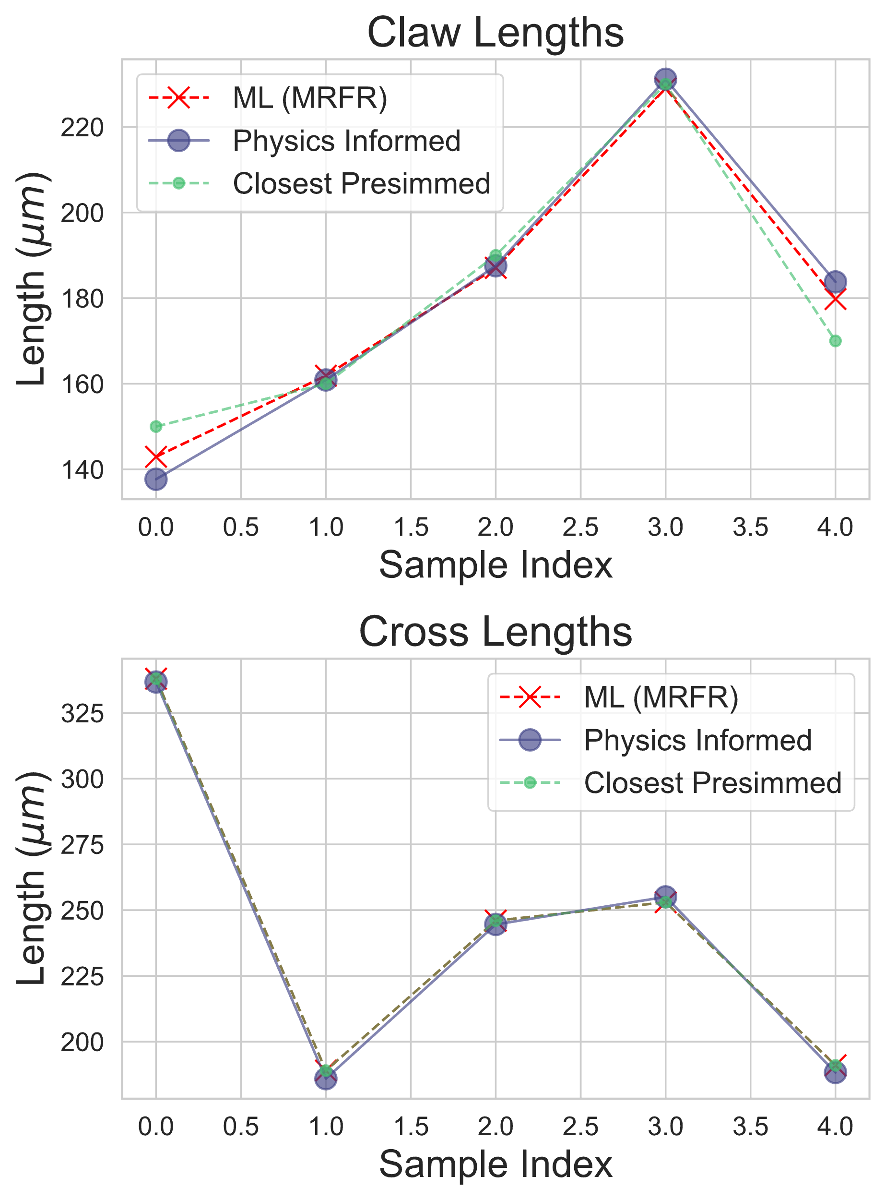
ML Inspired Interpolation Algorithm
Learnable Structures in our data
Invertible Neural Network (INN) with repetitions of RealNVP coupling layers Architecture ^{[1]}
Blackbox Multi-nodal RandomForestRegressor (MRFR) Architecture
Picks up on the physics on the problem
Needs more training data…
^{[1]} Nugraha Et al., https://doi.org/10.1109/QCE57702.2023.00154

Slide 11
Tutorial 3 Objectives
Understand how to use SQuADDS to create a dataset for ML application
Train a simple ML model on the SQuADDS Dataset
Evaluate, Simulate, Benchmark and Deploy the ML Model

